Slide 1

Forecasting Bicycle Rental Demand
Data Analysis & Model Implementation for Optimized Bicycle Logistics
Naseeb Grewal

Slide 2
Agenda
Introduction & Business Objectives
Data Analysis Overview
Forecasting Model & Performance
Implementation Strategy
Refresh Intervals & Planning Horizon
Key Benefits & Next Steps

Slide 3
Business Objectives & Context
Objective: Ensure the right number of bicycles are available year-round.
Key Question: How many bikes should be ready each hour/day to meet demand?
Impact: Improve operational efficiency and customer satisfaction.

Slide 4
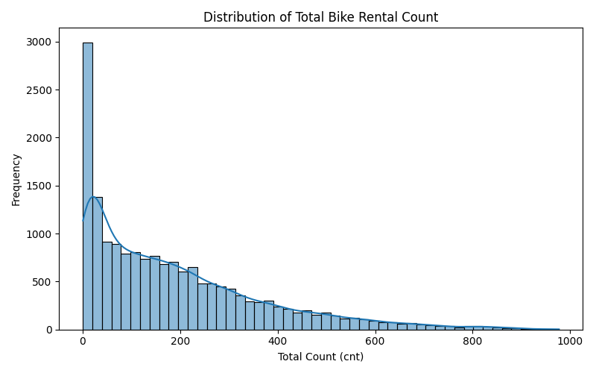
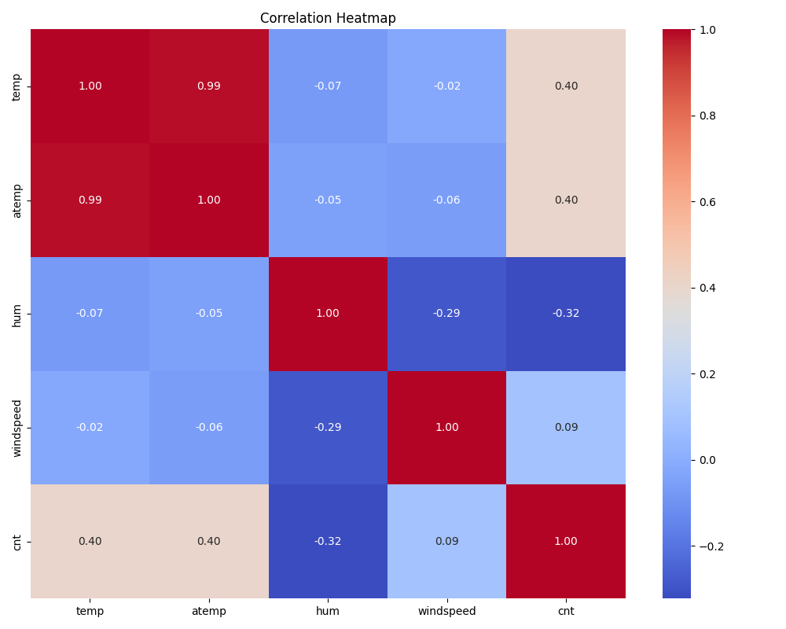
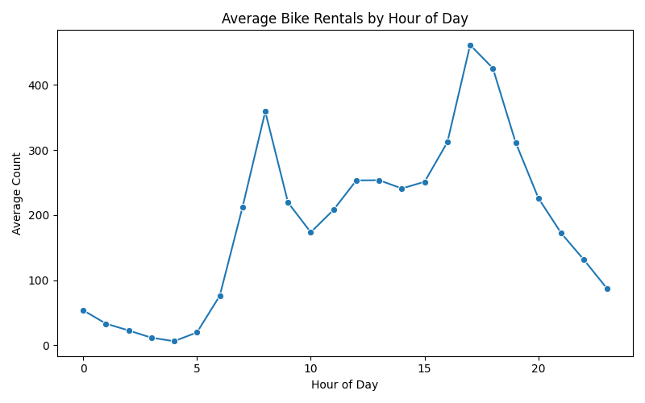
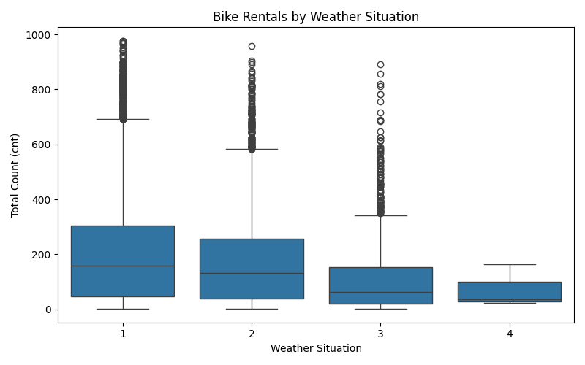
Data Analysis Overview

Slide 5
Forecasting Model – RandomForestRegressor
Model Choice: RandomForest selected based on best performance (MAD: 32.86).
Strengths:
Handles nonlinear patterns and feature interactions.
Provides clear feature importance for operational insights.
Robust and scalable for high-dimensional data.

Slide 6
Model Performance & Key Findings
Performance Metric: Mean Absolute Deviation (MAD) = 32.86.
Interpretation: Lower MAD indicates more accurate hourly demand forecasts compared to alternative models.
Insights:
Strong seasonal and hourly usage patterns.
Reliable performance for operational decision-making.

Slide 7
Implementation Strategy
Integration: Deploy model into the existing IT infrastructure with regular data updates.
User Interface: Simple dashboard for planners showing hourly and aggregated forecasts.
Training & Support: Provide documentation and training sessions for staff.

Slide 8
Forecast Refresh Intervals & Planning Horizon
Refresh Intervals:
Operational Forecasts: Refresh forecasts daily to capture recent trends and weather updates.
Planning Adjustments: Weekly updates are recommended to account for changing patterns without overloading planning cycles.
Why: Daily updates ensure high responsiveness, while weekly refreshes balance operational agility and long-term planning.
Planning Horizon:
Short-term (up to 1 week): Reliable hourly forecasts support day-to-day operations.
Long-term: Use aggregated seasonal trends for annual planning, acknowledging that model accuracy decreases with longer horizons due to unforeseen factors.
Why: The model leverages strong seasonal patterns; however, real-time weather and local events can introduce variability beyond a week.

Slide 9
Key Benefits & Business Impact
Operational Efficiency: Better allocation of bicycles, reducing shortages and surpluses.
Customer Satisfaction: Higher availability of bikes during peak times leads to improved service.
Cost Savings: Optimized logistics reduce operational costs and resource waste.
Data-Driven Decisions: Enhanced planning accuracy builds confidence in operational strategies.

Slide 10
Summary & Next Steps
Summary:
Proven forecasting model with a MAD of 32.86.
Actionable insights from data analysis support optimal bike availability.
Practical implementation with daily to weekly forecast refresh intervals.
Next Steps:
Pilot deployment and integration testing.
Training sessions for planning staff.
Regular review and iterative improvements based on feedback.

